Slide 2


Mapping Motives Tells a Story:
Analysis of 2,000 Enterprise Cloud Detections
DAVID WOLF
Security Innovation Researcher
JOSHUA SMITH
Security Content Engineer

Slide 3
Session Content
About Devo SciSec Innovation
Research Methods and Scope
Findings by Theme
Automated SOC
Augmented Analyst
Alert Management
Takeaways and Lessons Learned

Slide 4
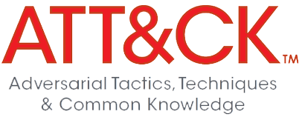
About Devo SciSec and Innovation
MISSION:
RESEARCH THEMES:
RESEARCH PROCESS:
1. Automated SOC Controls
Detective
Corrective
Preventative
Assess
Prioritize gaps
Tune defenses
Conduct security research on emerging threats and customer security problems to deliver novel security use cases.
2. Augmented Analyst
Empowered
Enabled
Educated
Assess Defensive Coverage
Identify High Priority Gaps
Tune and Acquire New Defenses
3. Alert Management*
Customizable
Reusable
Across vendor products
* Reported #1 analyst pain point from Devo annual SOC Performance Report

Slide 5

About Devo SciSec Research Lab
Team
- Detections Engineers
- ML/AI Data Scientists
- Security Researchers
- QA
Technology
- Detections (product content)
- ML models
- Test infrastructure (vendor products)
- Cloud providers (AWS, GCP, Azure)

Slide 6
Research Methods and Scope
Methods
Scope
Devo SciSec security researchers:
Analyzed cloud SIEM detections from more than 300 enterprises and MSPs that have active, firing alerts.
Applied novel machine learning (ML) and natural language processing (NLP) to alert metadata in order to map detections to MITRE ATT&CK® and Zero Trust Architecture.
Explored further ML and NLP methods to analyze cloud alert metadata as a corpus in order to map attacker motives and stories using semantic relationships.
6035 alerts used in analysis (15141 alerts in sample)
Sample period: 1 August-31 December 2022
398 SIEMs (Devo domains) with out-of-the-box (OOTB) alerts deployed
Enterprises span industries, including:
MSSPs, financial services, retail, technology, education, and operational technology (manufacturing, hospitals, transportation, etc.)
Federal and defense-related detections are not in scope

Slide 7
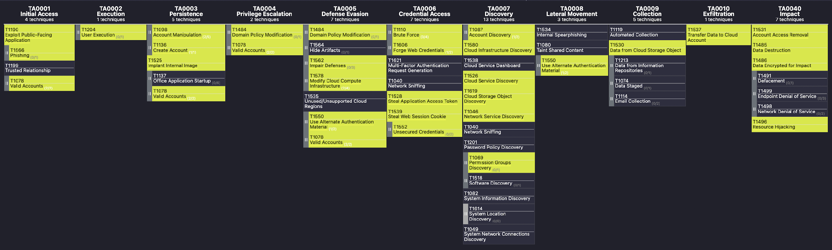
Scope: MITRE ATT&CK® Cloud Matrix: Infrastructure and Workspace Controls
The cloud alerts used in this research mapped to MITRE ATT&CK® Cloud Matrix Tactics and Techniques

Slide 8
Scope in Graph Form
Detections used in final analysis vs removed from sample
Detections by alert management responsibility
Number of employees per enterprise (excludes MSSPs)
Detections mapped to MITRE ATT&CK® framework
Detections based on cloud providers vs traditional enterprise detections
Detections per enterprise vertical (excludes MSPs)
Detections mapped to Zero Trust Architecture framework
Out-of-the-box detections vs custom-crafted detections
Detections per enterprise location

Slide 9
1. Automated SOC

Slide 10
Automated SOC: OOTB Key to Cloud Control
Cloud SOC defenders are relying on out-of-the-box detections (84%) and only 60% as likely to build custom SIEM alerts compared to enterprise defenders
Source: 2022 Devo State of the Cloud SOC Detections Report

Slide 11
Automated SOC: Cloud Control Coverage
Enterprise SOCs with Amazon AWS are often defending another cloud (59%)
For 1 in 4 enterprise SOCs defending cloud assets, cloud detections comprise a majority (50%+) of the SIEM detection stack
Source: CISA Zero Trust Maturity Model
Source: 2022 Devo State of the Cloud SOC Detections Report

Slide 12
Automated SOC: OOTB vs Custom SIEM Alerts
Managed Security Service Providers (MSSPs) are more likely than enterprises to craft custom detections. Overall, 84% of enterprise detections are OOTB, compared to only 55% of MSSP detections.

Slide 13
Automated SOC
TOP TAKEAWAYS:
Out-of-the-box detections are the key to cloud SOC automation
Cloud is a major control area and often a majority of automated SIEM alerts

Slide 14
2. Augmented Analyst

Slide 15
Augmented Analyst: MITRE ATT&CK Visibility
Labeling alerts shows gaps in cloud coverage. Overall, Cloud SOC analysts have less visibility at the start and end of the MITRE ATT&CK® chain compared to enterprise defenders (12.1% vs 22.1%)
 | TA0001 Initial Access | TA0002 Execution | TA0003 Persistence | TA0004 Privilege Escalation | TA0005 Defense Evasion | TA0006 Credential Access | TA0007 Discovery | TA0008 Lateral Movement | TA0009 Collection | TA00010 Exfiltration | TA00040 Impact
Cloud Detections | 4,87% | 0,29% | 28,17% | 13,47% | 12,45% | 12,35% | 12,61% | 2,84% | 2,51% | 1,58% | 8,87%
Enterprise Detections | 6,97% | 6,29% | 13,54% | 15,39% | 11,34% | 15,16% | 11,46% | 5,65% | 1,12% | 2,10% | 10,98%

Slide 16
Augmented Analyst: Zero Trust
Most SOC detections focus on Zero Trust Device and Network activity (74%) with far fewer controls based on User Identity, Application Workloads, and Data

Slide 17
Augmented Analyst: Device Protection
Detections based on the three most common types (endpoint device protection, cloud logs, and firewall solutions) are the basis for most enterprise SOC controls (83% of detections)

Slide 18
Augmented Analyst: Cloud controls
Cloud SOC defenders are focusing most detective controls on AWS (57%)

Slide 19
Augmented Analyst
TOP TAKEAWAYS:
Cloud SOC analysts need support via specialized detections to defend multiple clouds, especially for enterprises on AWS
Cloud SOC analysts need more visibility at the start and end of the MITRE ATT&CK® chain

Slide 20
3. Alert Management

Slide 21
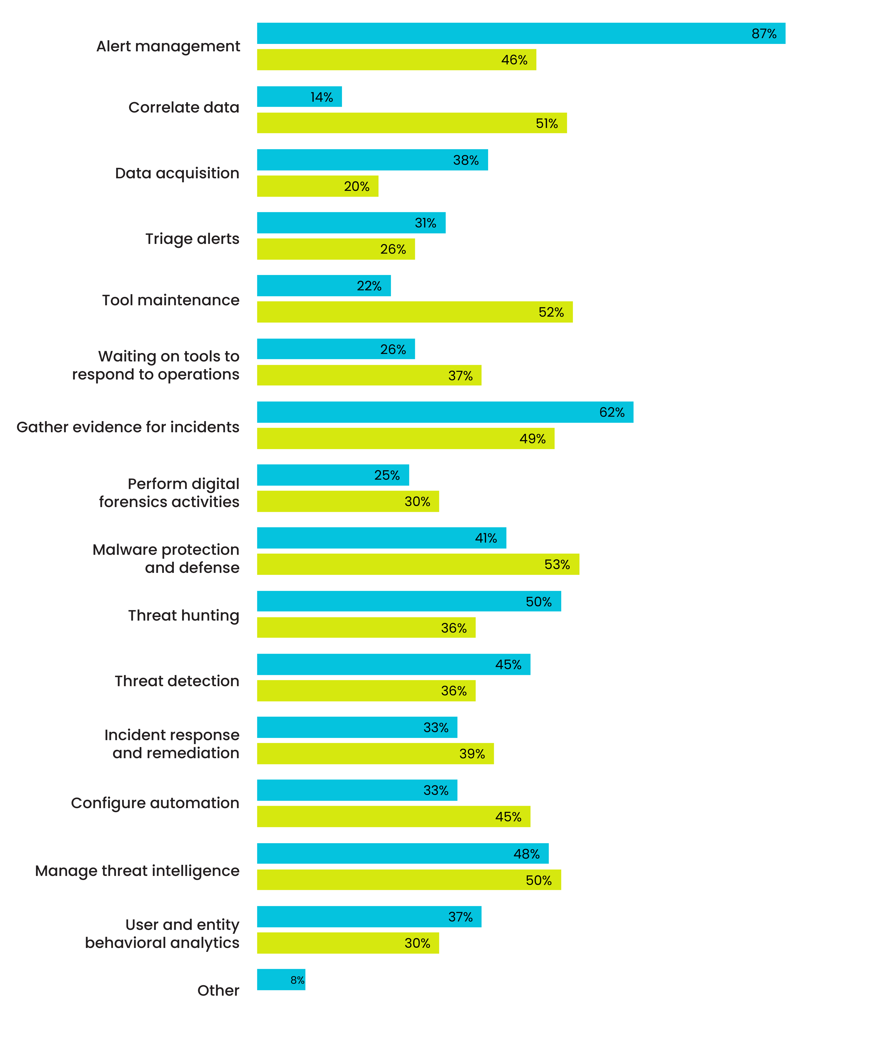
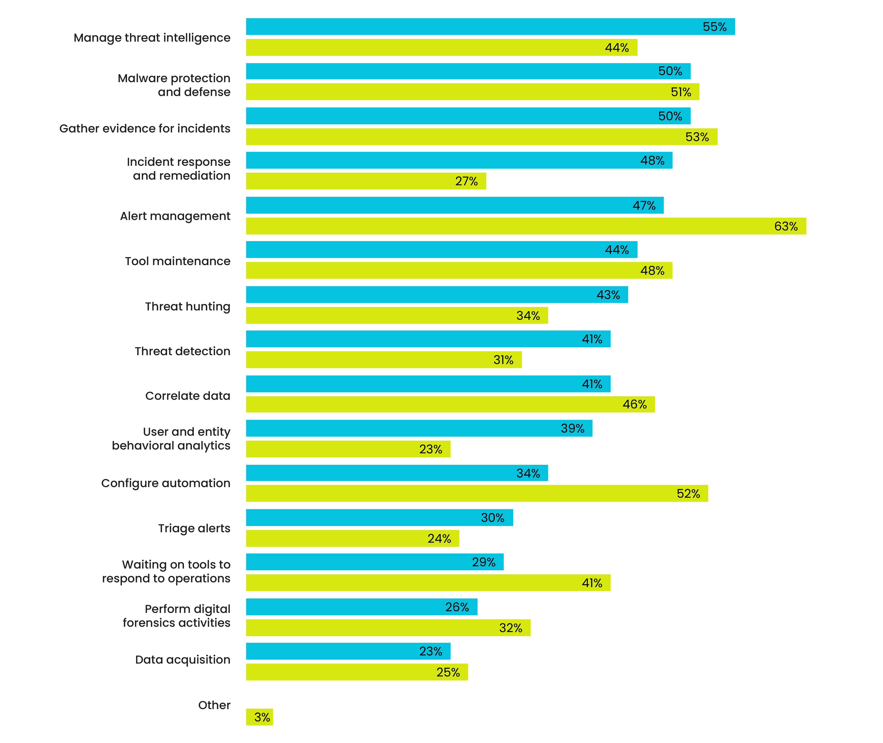
Alert Management: Devo SOC Performance Report
Alert management is the #1 pain point and area for improvement reported by high-performing SOCs (87%):
SOC analyst staff report alert management as #1 area in need of support (63%):

Slide 22
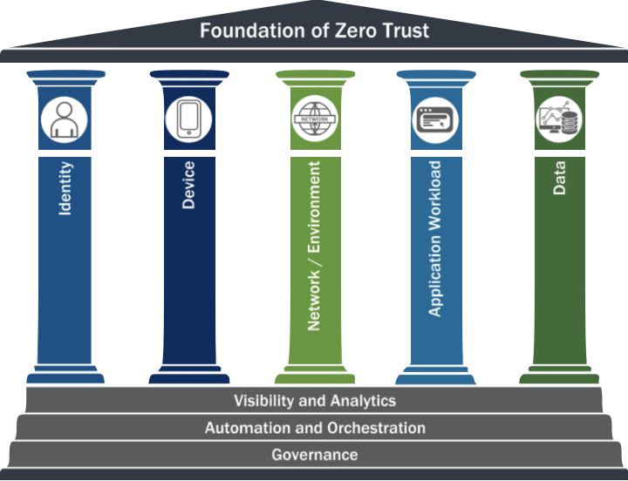
Alert Management: Zero Trust Framework
Source: CISA Zero Trust Maturity Model, 2021

Slide 23
Alert Management: Zero Trust
Most Cloud SOC detections focus on Zero Trust Visibility and Workloads (79%) while traditional Enterprise SOC detections are focused on Device and Network activity (83%)
 | Device | Visibility | Network | Workload | Identity | Data
Cloud Detections | 6,23% | 63,58% | 3,94% | 15,75% | 9,43% | 1,07%
Enterprise Detections | 62,29% | 4,91% | 20,82% | 0,57% | 10,33% | 1,09%

Slide 24
Alert Management: Cloud Detections Matter
“Banks are technology companies with a banking license” –Many Bank CEOs Cloud is most prominent as a ratio of detections in Financial Services and Technology (27%)

Slide 25



Alert Management: Current Auditing Options by Cloud Vendor
Amazon Web Services (AWS)
Logging and events
Visibility and alerting
Automation
Secure storage
Custom
Google Cloud Provider (GCP)
Admin Activity audit logs
Data Access audit logs
System Event audit logs
Policy Denied audit logs
Microsoft Azure
Activity logs
Azure Resource logs
Azure Active Directory reporting
Virtual machines and cloud services
Azure Storage Analytics
Network security group (NSG) flow logs
Application insight
Process data / security alerts

Slide 26
Alert Management
TOP TAKEAWAYS:
Out-of-the-box detections are the key to cloud SOC automation
Cloud is a major control area and often a majority of automated SIEM alerts

Slide 27
Lessons Learned:
Cloud is Big: Cloud is a big part of the enterprise detection stack, and enterprises are increasingly defending multiple cloud infrastructure and workspace providers
Augment the Analyst: Analysts need alerts that are augmented with rich metadata like MITRE ATT&CK tactics and techniques
The 5 Kinds of Detection: Help analysts by mapping alerts to a control area: Cloud, Network, Device, Identity, Other
OOTB for the Win: Cloud controls are different – OOTB strategy is the way to go
Use a Strategy: Mapping detections to frameworks increases interoperability and ease of alert management

Slide 28

THANK YOU

